Slide 1
Matrix Hands On Introduction
Instructor: Mark Schell
Time: Approximately 3 hours

Slide 2
Topics For Today
Tech Requirements, Status and Property Types
Front Page Widgets
Market Watch
Hot Sheets
My Information
Creating Contacts
Searching Matrix
Displays and Results
Direct Email Listings
Printing Listings
Auto Emails
Broker load/input
Notes:
On the Agenda for today we are going to take a look at - the Front page, The widgets and Making Matrix yours
We will look at Hot sheets/Open house/Direction feature- what u can do with these and how to customise them.
Look at creating contacts, and how to manage them.
We will go through the “MY INFORMATION” tab, and personalizing Matrix
Searching in matrix and tips and tricks in searching
Emailing and Printing listings for clients and as well as setting up auto emails to send to your clients.
Then we are going to talk about to broker loading or adding your own listing and finally talk a little about the Mystore account.

Slide 3
Technical Requirements
Works on all Current and Updated Operating Systems
Windows 7,8.1,10
macOS 10.12
Works with all Current and up to date browsers
Chrome
Firefox
Safari
Edge/Internet Explorer
Works well on both iOS and Android phones
Presents a mobile version of the site
HomesHQ App can be used to search listings on the system

Slide 4
Status Definition
Active | A | Active and live on the system. Available for showing and auto emails
Active – CS | ACS | Listings that are Active, or Sold Conditional, but are marked as Continue to Show
Active – NS | ANS | Listings that are Active, or Sold Conditional but are marked as Do Not Show
Pending Sale | P | Listings that moved to the status of Pending Sale (Sold Firm – not yet closed)
Sold Closed | S | Listings that moved to the status of Closed
Cancelled | C | Listings that moved to the status of Cancelled
Expired | X | Listings that moved to the status of Expired
Suspended | SU | Listings that moved to the status of Suspended (Cease Action)
Incomplete | I | Incomplete but saved listings

Slide 5
Property Type Definition
Single Family | All Residential properties freehold or condominium
Land | All Vacant land and lot listings
Commercial | All Commercial listings either for the actual building and property or for the business
Farm | All Agricultural properties,
Multi-Family | Properties and listings that are a building of units, such as an apartment building or duplex/triplex
Cross Property | Not a listing type, but a search type that encompasses all property types in a single search

Slide 6
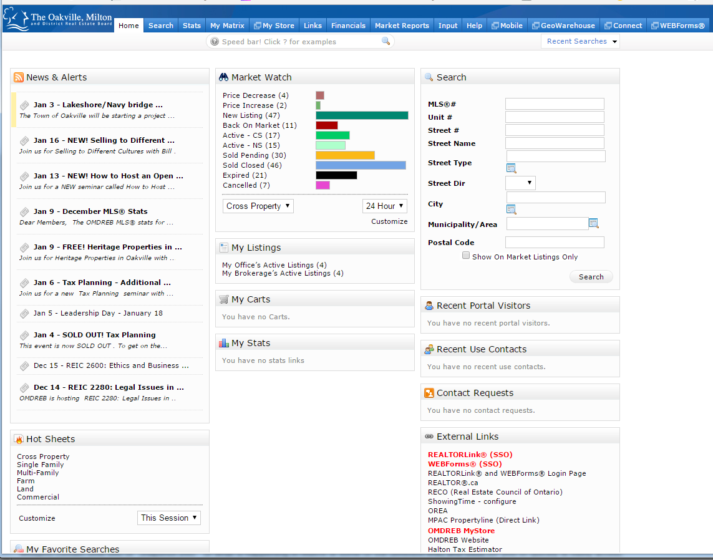
Home Page Of Matrix
Seen when first Logged in
Contains the Widgets for quick use
Customize by Moving widgets
Automatically Saves Layout
Notes:
This is the home page of Matrix and you will notice there are different boxes around the page that we call widgets.
Widgets contain little bits of “Snapshot Info” of what is happening in Matrix & some of the different links and tools for you to quickly & easily access.
You can move these widgets around by hovering over the title box, clicking & dragging around. You can place them wherever it works best for you.
---------------------------------------------------------------------------------------------
Explain Widgets and moving them and then switch to live demonstration
-Move a couple widgets around
-explain that yours are probably different because you have been moving them around
Talk about navigating matrix through the tabs at the top of the screen, they can be used to quickly access sections of matrix from almost anywhere

Slide 7
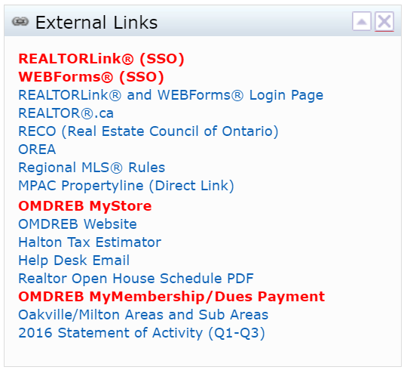
External Links
Helpful webpages for members
Notes:
First one we talk about is External links Widget: This includes links out to webpages we thought would be useful to our members.
There a school board map, tax calculator for the region, staff directory if you need to contact us, Board of directors, and several other links.
Unfortunately you can’t tailor these yourself, but if there is a link that you think should be up there please let staff know and we will look into having it added it for you.
One of the new features in this list is the youtube tutorials, click the link to be taken to a playlist of all of the videos.

Slide 8
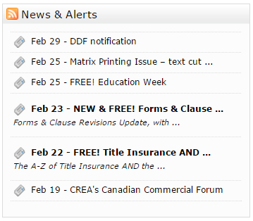
News and Alerts
Current Events and Important Notes
Only Widget that cannot be moved
Agent Alerts:
Expiring listings
Reported as Pending
Moving from Pending to Sold
Notes:
Next is our current news widget.
This is the only widget that cannot be moved as it is always locked in the top left corner.
It includes announcements from the board, upcoming seminars, system upgrades or interruptions from 3rd party providers (Georwarehouse, Webforms, etc),. Really just anything that might affect our members.
If it’s an important announcement, it will pop up and cover your screen when you first log in. You just need to click on the bottom, either read later, or I’ve read this so that it doesn’t pop up again.

Slide 9
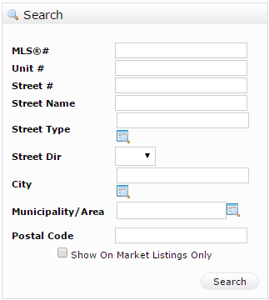
Search Widget
Quick Search
Fast Access to listings
Property History Search
Check box to show active only
Not a full search

Slide 10
Additional
Move Unused widgets in to this widget to store
Move widgets out of additional to put back on page for use
X on widget title bars move them into Additional
The Triangle minimizes the Widget to just the title bar
Notes:
Next we have the Additional widget. This is like a storage shelf.
So if there are widgets you are not using, you can drag and drop them onto the additional widget, which shrinks them down and stores them away there. This helps clean up your home page.
When you want to use them later, you just drag them out and they become available to use again.
One issue that occasionally comes up, especially on mobile devices – is that sometimes widgets get accidently dragged into the additional widget.
A common thing that happens is members have reported they are missing widgets. What has happened is that they have been using a touchscreen device and either accidently dropped the widget into the additional box or clicked the x in the right corner of the title of a widget and it has closed into additional (demonstrate). If you find that you have a missing widget have a look in additional first it is possible that it has ended up in there by accident

Slide 11
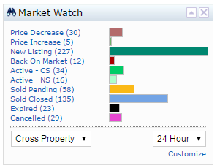
Market Watch
Quick Snapshot of changes on the MLS®
Click the change type to see the list
Organized by Change type
Change Property type with Dropdown
Change Time Period with Drop down
Tailor criteria using customize link
Notes:
The Market Watch Widget is a quick glance of everything that is changing on the board.
It is broken down by the change type, so if you click on one of the headings here you can see all the listings with just that change type, without running a full search.
For instance, if I just wanted to see new listings - I click onto new listing, it will show me all the new listings posted within the last 24 hrs.
The default for this is Residential – 24 hours showing all listings with status changes or price changes, which can be changed by using the drop boxes.
Keep in mind – Today means midnight to midnight period, so if a listing goes on at 11.59 it will drop off the Market watch and Hot Sheets at midnight.
{DEMO}
We can also customise the market watch to make it more relevant to our needs, i.e.. single sub districts, a price range, etc., click on customise link. That will take us to this screen and put in the criteria we want to customise for our market watch. I.e. want to look in a single sub district, we select it and click save and now market watch will only be showing changes for that sub district.

Slide 12
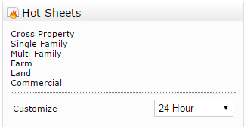
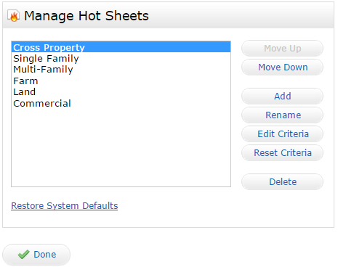
Hot Sheets
By Default 1 Basic Hot Sheet for each Property type (all Changes)
Click customize to add Sheets
Can add a combination of up to 10 hot sheets
Notes:
Hot sheets are similar to the market watch but instead of just one change type at a time, it shows all changes to listings. It will show everything from new listings to price changes, to cancelled listings, to back on market – all in one list.
By default, this widget includes 1 Basic Hot Sheet (showing ALL status and price changes) and one Basic Open House – which lists ALL open houses currently posted on the Board, public and realtor.
The Hot Sheets Widget can be customised to make them more relevant to our interests. If you are working in a specific area or price range Hot Sheets can be created for those. They can be as narrow as a single street or change type and as broad as every listing on the MLS®.
Up to 10 different Hot Sheet or Open House lists (total combined) can be added to the widget.
Click customise to access the Manage Hot Sheets screen

Slide 13
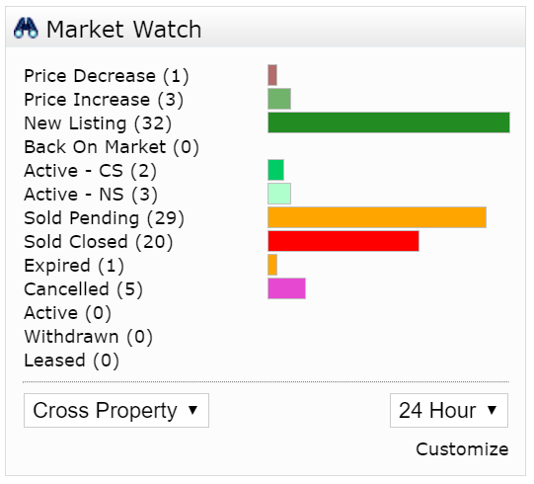
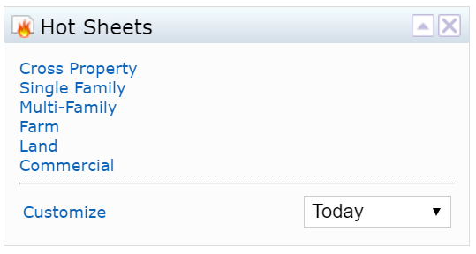
Class Activity: Market Watch/Hot Sheets
Time 10 minutes
Customize the market watch
Reset the criteria
Create a new hot sheet
Customize its criteria
Delete a hot sheet

Slide 14
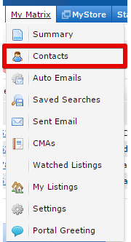
Contacts
Located under “My Matrix > Contacts”
List of Marked properties/notes
History for client interaction
Notes:
To access the Contact Manager hover over My Matrix and click the Contacts option.
This will take you to the contact manager, which contains a list of all contacts entered, activity details for each contact, history for each contact and anything created within Matrix for them like CMA’s, Auto emails and Saved Searches etc. (Saved Searches and CMA’s are covered in the Advanced Course)
Click on a Contact name to view details {DEMO}
You can also add, edit and manage your contacts information from this page
Clients can be made inactive by selecting them and clicking the set inactive button, this can be used to take a client off auto fill options but not lose the history with them
To reactivate them click the show inactive button, select the client to activate and click the set active button, to return to actives click the show actives button
{DEMO Active/Inactive}
To add a contact click on Add.
When you see a yellow field in Matrix, that is a mandatory field, needs to be filled out before can save anything. In this instance its first name last name and email address.
You can also set a custom salutation which will auto populate for each email you send to this client.
From this screen you also can select whether you would like this contact included in Reverse Prospecting.
From the contact list u can see different things we’ve done with those contacts. In this case I can see I have 2 auto emails set up, 4 saved searches, 9 cmas and I’ve sent him one email. As u work with different contacts u will build up a history with them and u can see all the things you’ve sent them.

Slide 15
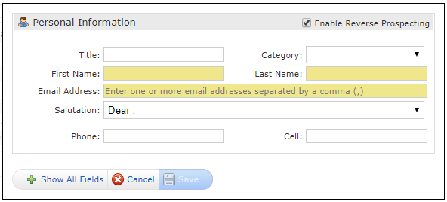
Creating a New contact
Click the Add button
Fill out the information and click save
NOTE: Yellow fields are mandatory
Multiple Emails may be entered use a comma to separate

Slide 16
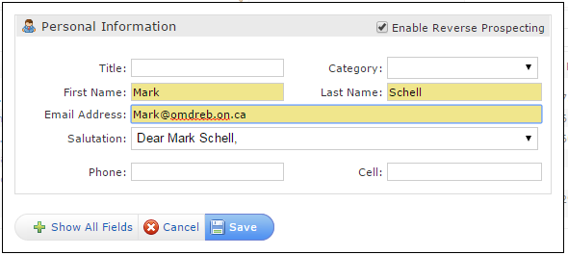
Class Activity
Time 5 Minutes
Create the Instructor as a Contact

Slide 17
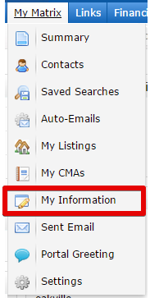
My Information
All Contact information about the Member including
Header/mobile header
Portal Information
Email Signature
Located on the My Matrix Menu
Notes:
My information is where contact information for the member is stored and customized.
Information from here is used to populate the portal, header, and mobile header info.
This section also allows for the customization of the Email signature.
To access My Information hover over the My Matrix tab and click the Settings Option. This will open up the settings page and the My Information section is located at the top. Click on the My Information heading to go to the information tab
(DEMO)
Go to the Settings page and show where the links are, click on my information and then come back to the slides to start talking about the various sections

Slide 18
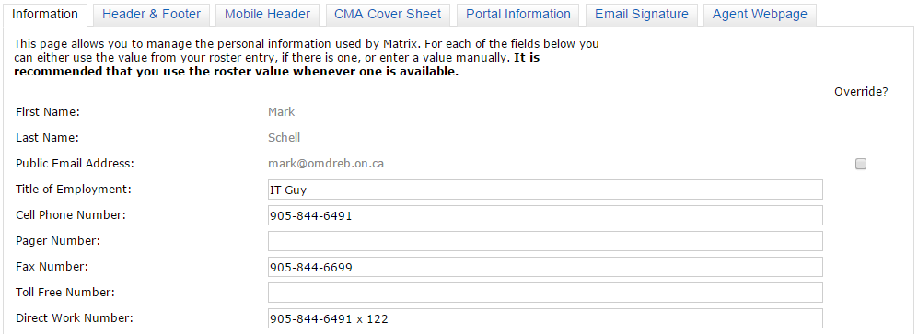
Information Tab
Set all information to be used for the other sections of My Information
Click save to update information
Notes:
This is the My Information page. The tabs can be used to navigate to the different sections of my information.
First we will talk about the Information tab. This is where you can customize all your information as well as enter any contact information, slogans, alternate emails, phone numbers or websites, this information is used for the other sections of my information. Enter any information desired into the boxes and click the save button to update this information. Note, you can override your email address but this does not update our membership database, if you need to change your official email that you have on file with the board please either use the my profile section of my store (shown later in the presentation) or contact the membership department.
The information setup on this tab is used in several other sections on the My Information page. Any time you want to update the information displayed on the other sections come back to the information tab to update that information.
(DEMO)
Add some information to a couple of the sections and then give the class approx. 10 minutes to update their information

Slide 19
Header
Displayed at the top of the Portal and print reports
Select the Template to be used or the option to upload a custom header
Click Preview
Use the Change Photo link to upload a photo
To set portal colours click the colour box to set the colour wheel
Click Save to update the header
Notes:
Next we will move on to the Header. To access this feature, click on the Header and Footer tab at the top. The header is displayed at the top of your client portals and is also added to the top of most portal print reports. When you first click on the header and footer tab it will prompt you to select which header you would like to use. Members have 2 options, they can upload their own custom headers (something that can be discussed with the IT staff) or use one of the prebuilt template headers. Select the header you wish to use by clicking on it, then click the preview button to see what it looks like with your information on it. If any of this information needs to be updated that can be done back on the information tab. The background and foreground colours can be edited as well, either enter the hex number for the colour or click on the colour box to bring up a colour wheel.
Members can also upload a custom photo to use in their headers and in other sections of matrix. To do this click the use custom photo radio button and then click change photo. This will take you to the photo management screen, where you can store up to 3 photos on the system for use in the various sections of matrix. Click browse and navigate your computer to find the photo, then click open. This will save the photo for use. You can then use the box to crop the photo as desired for use on the header. The photo can be cropped differently each time it is used. Click Save to add your photo to the header.
(DEMO)
Show off the header and customizing the colours and how to upload the photo. Give students approx. 5 minutes to experiment with this section.

Slide 20
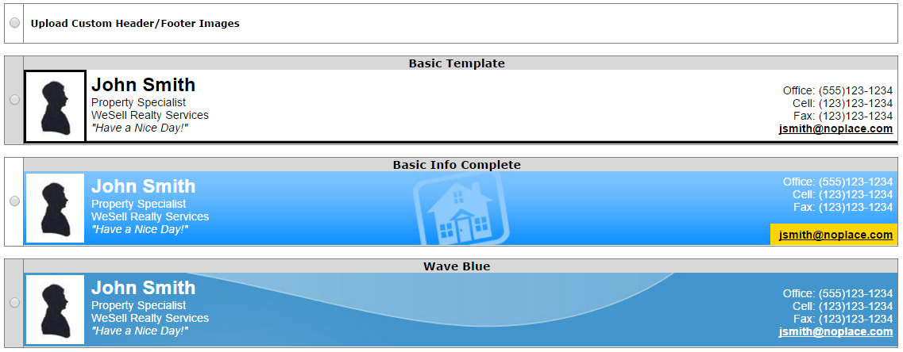
Class Activity: Setup Header
Time 5 minutes
Select a Template
Optional: Upload photo
Optional: Change Background Colour

Slide 21
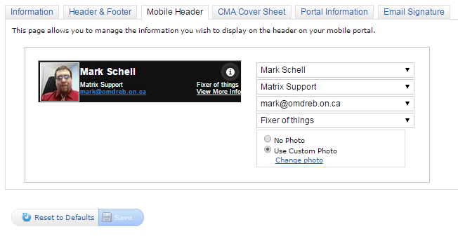
Mobile Header
Shown on the mobile version of the Portal
Set 4 lines of information for the header
Select the information from the Dropdown boxes
Dropdown boxes are populated from the Information tab
Set a photo for the Mobile header
Click save to update the header
Notes:
The next Section we are going to talk about is the mobile header. The portal where your clients view the listings that you send them has a mobile friendly version. If they access the listings through a phone or other mobile device it will be formatted and optimized for viewing on the smaller screen. Because it is smaller than the normal portal there is a special mobile header that will be used for this. To customize your mobile header click on the mobile header tab. On this page you can select up to 4 lines of information to be displayed by using the drop down boxes. The information in the boxes is populated from the information tab, if you want to update or add to these options that is done on the information tab. You can also display a picture on the mobile header using the same process as the header section. Click save to commit your changes and update the mobile header.
(DEMO)
Demonstrate changing the information and the photo, give the class approx. 5 minutes to explore

Slide 22
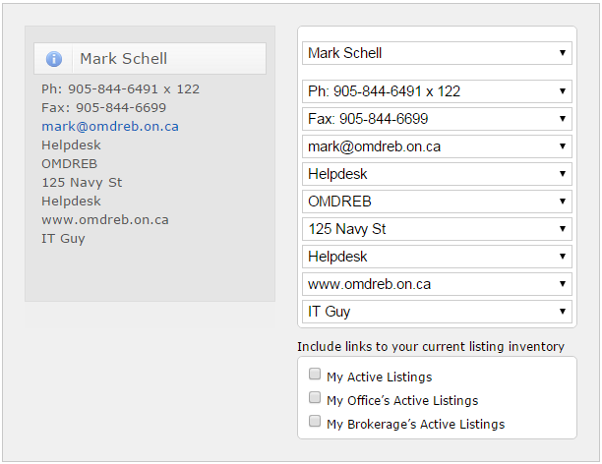
Portal Information
Displayed on the left side of the Client portal
Up to 10 lines of information
Preview of what it looks like on the left side
Click save to update the Portal
Use check boxes to include listings on the Welcome page of the portal
Notes:
The next section that we can customize is the Portal Information Display. This is a box displaying information; contact numbers, email addresses, office info as well as websites; this will be displayed on the home page of the client portal. To customize this feature click on the portal information tab. You can select up to 10 lines of information to be displayed, as you select the information it will update the preview on the left side of this page. The information in the dropdown boxes is populated from the information tab. After you have finished customizing the information click the Save button to commit the changes and update the portal.
(DEMO)
Show off the updating display and the dropdowns, give the class approx. 5 minutes to explore
(SPEAKER NOTE)Ask for any questions about the my information section before proceeding to the signature section

Slide 23
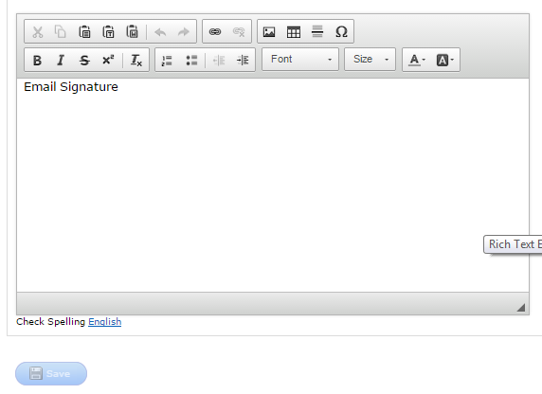
Email Signature
Appears at the bottom of all outgoing messages from Matrix
Fully customizable (font size/colour/style, images etc.)
Notes:
Now that we have covered the other sections of the my information page(SPEAKER NOTE: if they ask about CMA it is in the advanced course) we can talk about customizing the email signature.
The email signature will show at the bottom of all out going communications FROM the Matrix system. It is customizable with different fonts and text sizes, colours, links and images. A note on the images, they need to be hosted on a website or hosting service in order to be used for a signature, whether flickr, dropbox or a personal website. The images could also be taken from the branding page of a social media site or corporate brokerage web page but if they change the image it will break it in your signature. For information on how to host your images please contact the IT staff.
The Signature editor works like using word or other word processing software. Enter the text in the box, and to edit it highlight the text and use one of the buttons on the tool bar to alter the text.
When you have completed you signature click save, and this will update it so that it sends on all outgoing messages going forward.
(DEMO)
Give a demo of how to enter and edit the text, change the font and size, colour and add the board logo from the board website by using the copy URL function

Slide 24
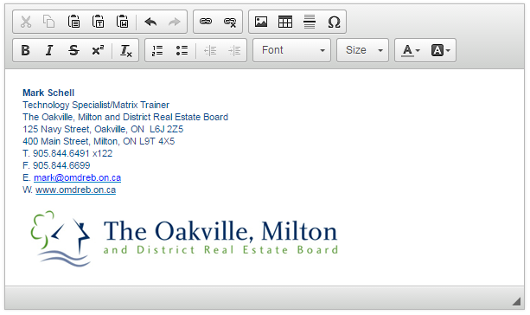
Class Activity: Setup Email Signature
Time 10 minutes
Create your Email Signature

Slide 25
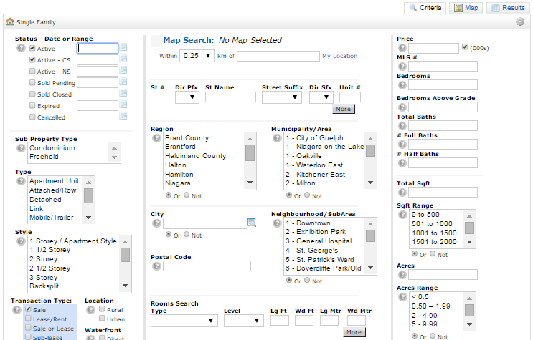
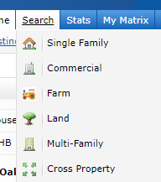
Searching Matrix For Properties
Notes:
Now we are going to get in to the central part of Matrix, searching for listings. To search for listings in matrix, hover over the search tab at the top and select the property type you wish to search for. For all the examples in todays class we will be using the residential search, but they all work the same, so anything you learn on this search is transferable to the other types of searches.
(DEMO) Navigate to the residential search then switch back to the slide
This is the search screen in matrix, it displays all of the criteria available to be searched by default.
At the bottom of the screen there is also a clear button that will remove the set criteria. There is also the count on the fly (x matches) which will tell you how many listings(results) match your current criteria in real time.
SPEAKER NOTE: Point out the clear button and the count

Slide 26
Navigating Searches
Try to avoid using the back button in the browser
Instead use the three tabs to navigate from any of the pages to any of the other pages.
This will prevent losing what you are working on
Notes:
Before we get in to the different types of criteria in matrix and how to use them lets talk about navigating the search area in matrix.
When searching in matrix DO NOT USE THE BROWSER’S BACK BUTTON or BACK FUNCTIONS ON YOUR DEVICE (SPEAKER NOTE: put extra emphasis on this) you will lose what you where working on.
Instead of using the back button use the tabs located up in the top right corner of the search screen; Criteria, Map, and Results. Clicking these tabs will allow you to quickly move between the sections of the search. For example if you are on the results screen and need to narrow your criteria click on the Criteria tab. If you want to go to the map click the map tab, and to get back to the list of results click the results tab. Using these 3 tabs will save you from losing any work you have done as well as make it quick and easy to navigate the search in Matrix.
(DEMO)
Go out to matrix and click around on the tabs while giving the examples and then return to the slide show

Slide 27
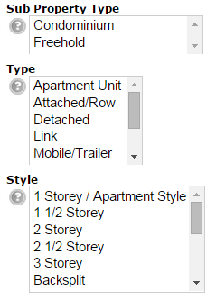
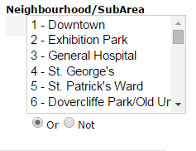
Multi Select Criteria
Status, District and Sub-district are multi select boxes that allow the selection of several options
Hold control and click on options to add or remove them
Use the “or” and “not” radio button to either include or exclude the selections
If multiple Districts are selected, the appropriate sub-districts will be in the same order as the Districts are listed
Notes:
The first type of criteria we are going to talk about is the multi select box. These allow the selection of multiple items to search for. Matrix will by default look for listings that match at least one of the items selected in the box. You can select multiple items by holding down the control key on a PC or command key on a Mac, for tablets if you select the criteria a pick list will pop up and allow you to select the items that you wish to use.
There is also another way that we can use the multi select boxes, instead of including items that match the criteria we can use the boxes to EXCLUDE the items. To do this select the items you want to exclude and click the NOT radio button below the box. Now instead of finding listings that match the selected items, it is going to exclude listings that match the selected items. An example of why you might want to do this is if you have a client that is looking in a district but has specific areas they do not want to live in instead of selecting all but those areas you could select those few areas to exclude and then click not.
There is one final way the multi select boxes can be used, on some of the criteria there is an AND option, with this option selected the search will look for listings that match at least all of the items selected. it could have more than the items selected but it has to have at least the ones chosen.

Slide 28
Street Search
Search by name but do not include type/direction
You can use a Wildcard to enhance your Search
* (Shift+8) is the Wildcard
Put an * before the word to search for anything ending in that word
Put an * after the word to search for anything starting with that word
Surround a word with two *’s to find anything containing that word
Use an ! before a street name to exclude the street name
Use the more button to search additional streets

Slide 29
Street Search Examples

Slide 30
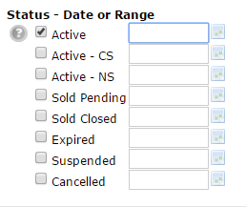
Date and Status
Status and Date can be searched together
Date searched corresponds to status type
Dates are exact, use the following to search
MM/DD/YYYY+ that day and forward
MM/DD/YYYY- that day and back
MM/DD/YYYY-MM/DD/YYYY for range
0 represents today
0-X : today and back X days

Slide 31
Price
Price searches are done in thousands by default
Search in a range by putting a “-” between the 2 numbers
Search greater than a number using a +
Search for less than a number using a –
The price that is search corresponds to the status selected
Notes:
When searching prices you search by thousands, so if you wanted to search for 500000 you would just type in 500, for 1 million you would just type in 1000. This gets a little tricky when searching for leases, if you wanted to search for 1200 you would type in 1.2, 2500 2.5 and for 10000 10. The easiest ways to help you remember this are to either move the decimal 3 places to the left or divide the number by 1000.
Prices are also free form typing criteria, they will search for the exact thing that you type in to the box just like street names. If you type 500 in the list price it will only find listings that are listed at exactly $500,000. To expand the search we can use several different symbols. If we put a plus(+) sign after the number it will find listings from that number and greater, if we put a dash (-) after the number then it will find listings from that price and less. If we put a dash(–) between two numbers without spaces for example 500-900 it will find listings with prices including and between those 2 numbers.

Slide 32
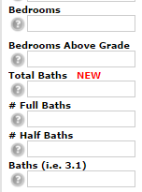
Beds and Baths
Number fields
X+ = that many and greater
X- = that many and less
X-Y = the range X – Y
Bedrooms: Any combination of above and below grade
Total Baths: Any Combination of Full and Half

Slide 33
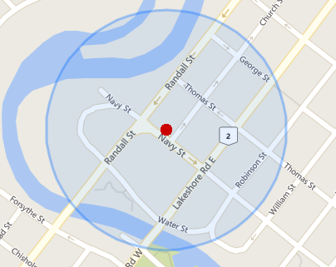
Location Search
Enter Address
Use dropdown box to select how large a radius to use
Automatically draws a radius on the map when searching

Slide 34
Room Search
Search by
Room Type
Room Level
Feature Code
Search multiple rooms by clicking “more”

Slide 35
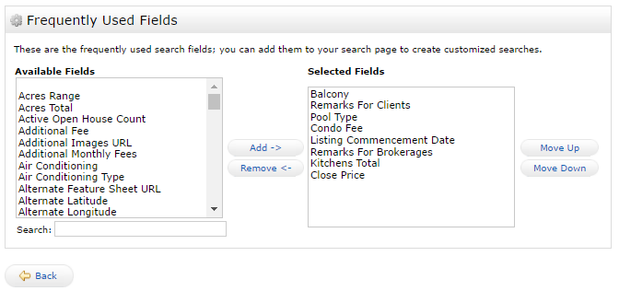
Adding Search Criteria
Add more fields to search by clicking the “add” link at the bottom of the Search page
Select the field from the left hand box and click “add”
Click “Back” to return to the search screen
The added fields will appear at the bottom of the page
Notes:
We can add additional criteria to search for in matrix beyond the defaults. To do this, navigate to the bottom of the page and click the add link beside the additional fields title. This will take you to a page where you can add the criteria you wish to search. If it is a field on the input form it can be searched. Find the desired criteria on the list on the left side, select it and click the add button this will move the criteria to the list on the right. Once you are done adding fields you can click the back button located at the bottom of the screen to return to the search screen. The fields that you added will now be located at the bottom of the default search screen below the additional fields title. These fields will stay from search to search until the are removed. To remove or rearrange the order of the additional criteria click on the add/remove link beside the additional fields heading. This will take you back to the page where you added the criteria previously. To remove a criteria select it on the list on the right side and click remove. To change the order of criteria select the criteria on the right side list and click the move up or move down buttons. Once you are done managing the criteria click the back button at the bottom of the screen to return to the search criteria page.
(DEMO) add a couple fields and show where they are located.

Slide 36
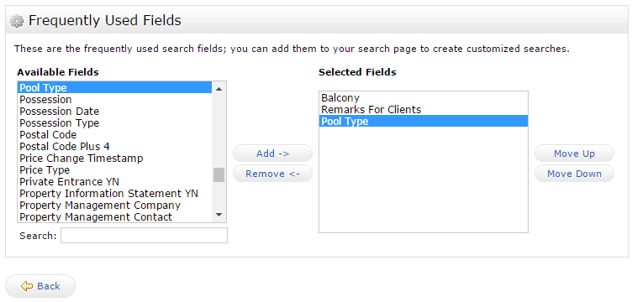
Class Activity: Adding Search Criteria
Time 5 minutes
Add the following criteria to your search screen
Balcony
Pool Type
Remarks for Clients

Slide 37
Open House Search
Find upcoming open houses (public or member)
Click on search tab
Scroll down and Click on Open House
Set criteria and go to results

Slide 38
Open House Search Demonstration

Slide 39
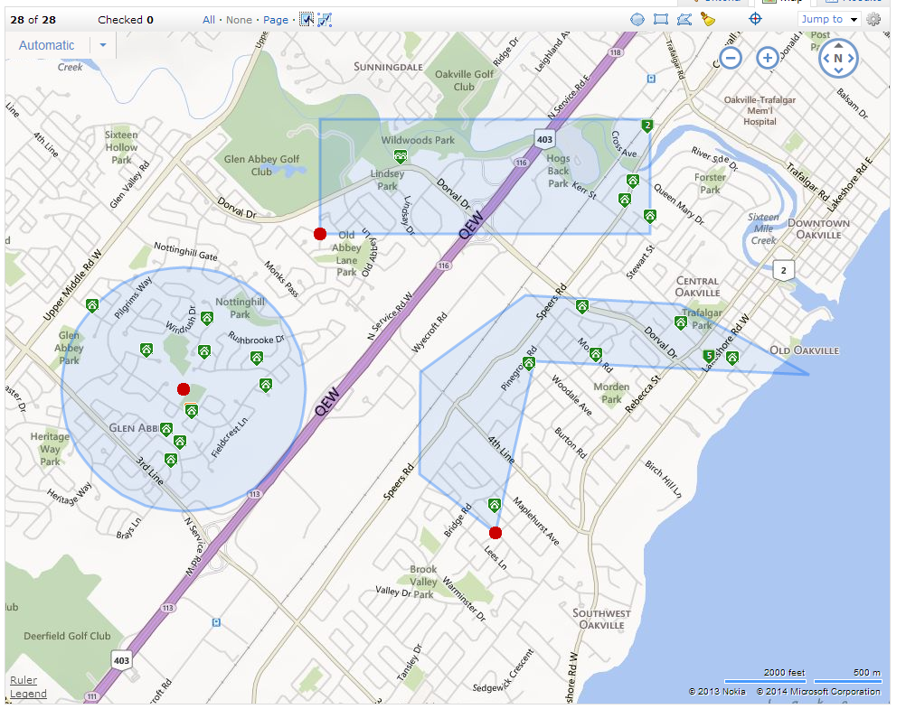
Searching with the Map
Can include or exclude Areas on the map by drawing shapes
3 shapes available: Circle, Rectangle, Polygon
Pins Colour-coded by status
Active
Active – CS or Active - NS
Pending Sale or Closed Sold
Expired or Suspended
Pins with a number in them are multiple listings on same address or location
Notes:
There is also another way that we can search for listings, we can use the map to look for listings in a geographic area without being constrained by sub districts. To do this we can click on the map search link or use the map button/tab to go to the map. On the map we can see clusters of listings and if we hover over the cluster we can see the area that set of listings is drawn from outlined in blue. If we click on a cluster it will zoom in to that area.
We can also draw on the map using 3 different shapes:
The first shape is the circle (DEMO Where button is located) Click on the map where you want the center of the circle and drag the cursor away from the circle. When the circle is the desired size click again to set the shape on the map. As you draw the circle there will be a box that displays the radius in km of the circle (DEMO Draw a circle on the map)
The second shape is the rectangle (DEMO Where button is located) and it works similarly to the circle. Click on the map for the first corner and then drag away to change the size of the rectangle. When it is the desired size click again to set the shape on the map. (DEMO Draw a rectangle on the map)
These work slightly different on a tablet. To create the shapes on the tablet, touch and hold for the red dot and then while holding your finger on the screen drag it around to set the size of the shape, to finish lift your finger off the screen and this will set the shape on the map.
The final shape is the Polygon. This is a very flexible shape that can be used to precisely define an area. (DEMO show where the button is) The polygon works a little different than the other shapes. The first click places the first corner and each click thereafter places another corner. To finish the shape click the red dot and this will set the shape on the map. (DEMO Draw a polygon on the map)

Slide 40
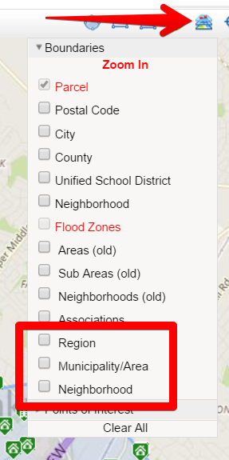
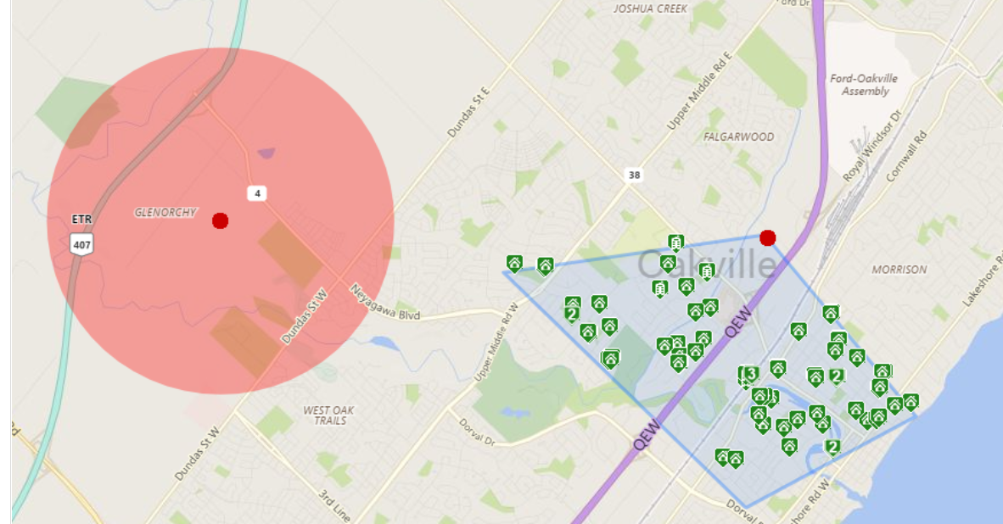
Map Options
Exclude shapes
Draw Multiple shapes and Layer them together
Jump to Address to place a pin on an address
Layers to draw out the area/neighborhood borders

Slide 41
Map Search Demonstrations

Slide 42
Lakeshore Search
Notes:
This is an interesting example of how to use the shapes to make your search more accurate for your clients’ needs.
A member asked if she could create a search for condos that where on the lakeshore but did not necessarily have a lakeshore road address. To accomplish this we drew a series of polygons all the way up the lakeshore so that when she entered her criteria (condo, price, features, etc) it would find listings along lakeshore road as well as all the little streets that run south of it.

Slide 43
Results Page: Displays
“Member Single Line” is the Default
Lots of information in a compact form
Click on the MLS® number to go directly to the listing
Click on any of the titles to sort by that column
The Display drop down can be used to change the view of the results
Up to 200 listings can be displayed at once
Use the Gear on the Right hand side to set the default sort/display
Notes:
To get to the results of the search either click on the results tab in the top right corner of the search screen or click on the results button on the bottom of the criteria (DEMO switching to the results)
The Default display in Matrix is the Single Line Grid. This display is very flexible and we will be focusing on how you can customize it.
To change to other views use the display dropdown menu. From this you can select various ways of viewing the listings (DEMO changing views) . At any time you can switch back to the single line by clicking on the Single Line Display link in the top middle of the results, remember do not use your browser’s back button. (DEMO)
If there is a display that you prefer to use as your default instead of single line, select it then click on the gear and select “Set as default view”. From now on when you come to the results screen it will default to the selected view instead of the single line display. To return to the single line display as your default select the gear and click return to system defaults.

Slide 44
Custom Displays Examples

Slide 45
Results Page: Icons
On the different Results page, there are icons that have various functions:
Map: Click this to see a map with the property marked
Pictures: Click to see a gallery of all the photos for that property
Property history: all Activity for that Address
Virtual Tour: click to see the virtual tour for that property
Brochure: click to see the brochure attached to the property
Supplements: click to see any PDFs
Open House: Click to see all scheduled Open Houses
Price Change: If the price has been adjusted up or down
Geowarehouse: Click to view property details on Geowarehouse
Webforms: Click to import information about the listing in to webforms
Notes:
On the various displays in matrix there are icons that can be used as shortcuts to various information about the listing.
The first icon is the Binoculars icon. This icon can be used to set the listing as a watched listing, once set as a watched listing you can view the listing in the my matrix -> watched listings list (DEMO)
The next icon is the globe icon. This will pop out a window with a map and show the location of the property. (DEMO)
The next icon is the camera icon. Clicking this will pop out a scrollable photo gallery for that property. You can also click on the icons in the lower right section of the photo gallery to view a list of all photos or to open the photo gallery for this property in another browser tab. (DEMO)
The next icon that looks like a little alarm clock is the property history icon, this icon will display all activities for this listing ONLY, not necessarily the property as a whole. It will display when the property was listed, any status changes as well as any price changes. (DEMO)
We then have the Film Strip icon. This icon will open up another tab and load the virtual tour for the listing. On OMDREB we allow for the use of youtube for virtual tours as well as branded virtual tours. (DEMO)
The next icon is the Brochure icon. Clicking this icon will open up a new tab with the alternate feature sheet or brochure for the property. (DEMO)
The final icon is the supplements icon. This icon will open up another tab with a list of pdfs for the listings. These can be things like floor plans, surveys or schedules for the property. (DEMO)
(SPEAKER NOTE: if the listing does not have a particular icon it means that the listing does not have the corresponding information or links)

Slide 46
Class Activity: Using the Display Options
Time: 5 minutes
Add and Remove a column from the display
Move and rename a column
Save the display
Set the member single line back to defaults

Slide 47
Emailing
Select the listings to send
Click the “Actions” menu
Click the “Email” button
Fill out the standard email form and click “Send”
Notes:
Matrix offers the ability to directly email a link to view the listing to a client. To do this select the listings that you wish to send out and click the email button at the bottom of the results screen. (DEMO)
This will take you to a standard email form where you can fill out a To, CC address and have the option to BCC the message. As you start typing in to the To or CC field it will suggest contacts to use from your contact list.(DEMO)
There is also a box to enter in the subject for the email and a place to put in a personalized message to the recipient.
By default emails will send the client/public views. There is an option to send the Full (All remarks) view if you are sending the listing to another member. To do this when filling out the email form click the addition link and then select full (all remarks) from the dropdown box. This will add the full all remarks report to the list of available displays on the portal for the recipient. (DEMO)

Slide 48
Printing Listings
Select the listings to print and click “Print”
Select the Report to use
Reports above the grey line of text are the same as displays
Reports bellow the grey line only print to PDF
Client Reports are public-friendly and can be emailed as PDFs
Notes:
Printing listings uses a similar process as emailing listings. Select the listings that you wish to print and click the print button at the bottom of the results. (DEMO)
This will bring you to the print listings screen. On this screen you can select which report format you would like to print for the selected listings. The reports above the grey line of text appear exactly the same as the views in the display drop down box on the results screen. The reports below the grey line are customized by the board as requested by members. If you have any suggestions on print report formats please contact the IT support staff to discuss them.
The most popular of these reports is the “Full 1 Page photos” and the “Portal – Full 1 Page photos”. These two reports will print on 1 page for the majority of listings. When selecting reports, if it is prefaced with the word portal is a public friendly report and is safe to give to clients.
The portal reports can also be emailed as attachments by selecting the report and then clicking the “Email PDF” button. This will bring you to a standard email form just like for emailing out listings.
(DEMO) show some of the different reports in PDF form

Slide 49
Auto Emails
Automated update for new listings and status updates for listings
Set up a Criteria for the search and review
Click the “new auto email button” under the “save” menu (no need to select any listings)
This will take you to the settings screen
Notes:
Auto Emails are a way to send scheduled emails to your clients. These emails will contain a link to the clients unique portal. This portal will display live listings based on a set criteria that you define for the client.
To set up an auto email we are first going to start with a fresh residential search. From here we can set the criteria for the client. The criteria can be as narrow or broad as desired except for 2 things, the results of the search cannot contain more than 250 listing and the status cannot be anything but active or conditional sale. Once the criteria is set up click on results. On the results page click on the Save menu below the results list and then click the new auto email button, this will take you to the auto email settings page. Remember with auto emails you do not need to select individual listings, the portal will be displaying all listings and updates that match the defined criteria. (DEMO process)

Slide 50
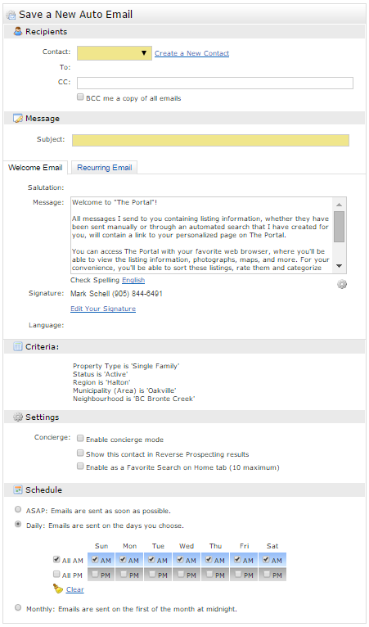
Auto Emails: Settings
Contact: Set which contact is going to receive the email
CC: Carbon copy recipients
BCC me a copy of all emails: Check this box to receive a copy of the auto email
Subject: Subject line for all update emails for this auto email
Welcome Message: Message for the initial Email
Recurring Email: Message for Update Emails
Schedule: Set the schedule emails will be sent on
Click save to send initial auto email
Notes:
After new auto email has been clicked you will be taken to the Save a New Auto Email page. This is where all of the settings of an auto email are defined; who it is going to, additional recipients, messages, and the schedule.
The first setting to configure is the recipient. This is set with the contact dropdown menu. Unlike with direct emails the recipient of an auto email MUST be a contact in your contact list. If you forgot to set them up before configuring the auto email there is a create a new contact link beside the contact dropdown box that will allow you to create that contact now. After you have selected the primary recipient of the auto email you can add additional recipients in the CC field. You can also checkmark the BCC box to receive updates to your registered email. (DEMO)
Next enter a subject line into the subject field, this will be the subject line for the welcome email and every update that is sent for this auto email.
You can then personalize both a welcome email and recurring email message for the auto email.
The Welcome Message is the first email and will be sent when the save button is clicked. This email will contain the message setup on this page as well as a link to the recipients unique client portal. This link is VERY important, if it is not clicked the auto email will not activate and the recipient will not receive any future updates for this auto email. Clicking on this link is your client giving you permission to send further emails to them. This qualifies as consent in regards to the Canadian Anti-Spam Legislation(CASL).
The Recurring Email will be the message that the client will receive every time there is a scheduled update for the auto email.
Next we can define the schedule for the auto email. Matrix offers 3 different scheduling types:
ASAP: an update email is sent every time there is a status change or a new listing is posted that matches the defined criteria
Daily: this will send an update email either once or twice a day depending on the selected options. The emails can be sent in either the morning, evening or both. Use the checkboxes on individual days to set when or if emails are sent on any given day. If a day is removed from the schedule any updates that happen on that day will be sent out with the next scheduled email. If the client visits the portal before an update, remember the list is live. Any updates or new listings will be displayed in the portal.
Monthly: sends 1 update email on the first day of every month
After all of the settings are completed click the save button to send the welcome email.
(DEMO)
Demonstrate some of the settings and the scheduling options.

Slide 51
Auto Email Alternate Settings: Concierge
Replaces normal Schedule
Allows filtering of listings before going to the Portal
After saving, goes straight to the list of properties for approval
Agent is notified of new listings for approval in 3 ways:
Widget on the front page
Link on the top of pages
Optionally and email notification if desired
Replaces scheduling options

Slide 52
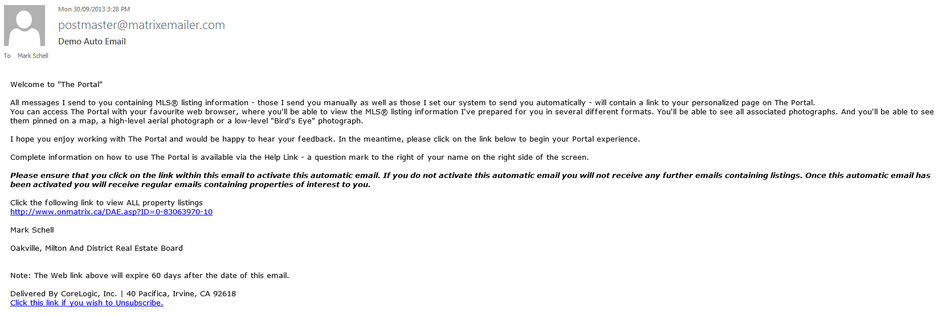
Auto Email: Initial Email
Sent to Client once Save is hit
Will include the custom message as well as some template information
Link must be clicked to activate the Auto Email
Notes:
After clicking save your contact will receive the welcome email for the auto email. This email will contain either the custom message that you set up or the default template email. It will also contain a link to the clients portal. This link is incredibly important, if the contact does not click the link the auto email will not activate and they will not receive any further updates for this auto email.

Slide 53
Auto Email Demonstration

Slide 54
Class Activity: Setting up an Auto Email
Time 10 Minutes
Run a search and go to the results
Click save and New Auto Email
Use the Instructor as the contact
Configure all the settings
Click save

Slide 55
The Portal
Notes:
The portal is where your clients view and sort the listings that you send them. There is a misconception about how listings are sent out to clients. Rather than sending the listings as attachments, the email will contain a link that takes the recipient to their unique client portal. The client portal then displays a live version of the sent listings.
When a client views the listings in the single line display format (which is the default for new clients) they can easily see which listings they have already viewed in detail and which listings are new since the last update email. Any listings highlighted in yellow are new or updated since their last visit to the portal. Listing highlighted in yellow will stay highlighted for 3 days or until read . Any Bold MLS numbers are listings that have not yet been viewed in detail.
On this screen the Listings can be seen on both the map an in a single line display. The Pins on the map also give a quick look at the property, if it has been marked the pin will show the logo of the folder it was put into, favorite, possibility or discarded. If the listing is new or recently updated it will be marked with a star.
The client can sort the listings into one of three folders. Favourites, Possibilities or Discards. To sort the listings they click on the corresponding icon either to the left of the MLS number on the single line display or below the picture on the other displays. The Heart will mark the item as a favorite and add it to the scrolling display on the portal home page. The Lightbulb is the possibilities icon, this is used as a maybe folder. The final icon is the Discard folder, when this icon is clicked the client will no longer receive update emails for this listing but a current version of the listing can still be viewed in the discard folder. (DEMO the different buttons)
The display can also be changed by using the Display drop down menu at the top of the page. This will allow the client to view the listings in all of the different client friendly views (DEMO). The client can also quickly access any of their photos by clicking on the icons in the top right corner of the screen. (DEMO)
To go to the Portal homepage click the welcome tab in the top right corner of the screen
(SPEAKERS NOTE: most of this will be demoed in a live portal rather than talking about the slides)
____________________________________________________________________________________________________________________________________________________________
Sort or discard listings into Favorites/Possibilities
Yellow highlight = new
Bold MLS® = unread listing
Change view using Display drop down Box
Click Welcome tab to see other sent emails
This view allows contacts to look through the listings and see them highlighted on the map
They can use the icons on the left side of the listing to mark or sort the listings
-Heart = Favorites
-Light Bulb = Possibilities
-Trash Can = discard (they will not received update emails about this property but it will still be viewable on the portal in the discarded list)
Contact can click on the notes icon to send notes about the property to the member or see that there is notes about the property for them
Contacts can use the drop down boxes at the top of the screen to quickly change how the listings are displayed or switch between emails the member has sent them
Click welcome to go back to the home page of the portal and move on to the next slide

Slide 56
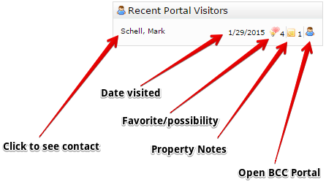
Recent Portal Visitors
Shows Recent contact activity and when they last accessed their Portal
Click the heart/lightbulb Icons to see listings marked
Click on the Note icon to see any listings with notes
Click the little person icon on the right side to see their portal in BCC mode
Click their name to access the Client’s information page
Notes:
The recent portal visitors widget displays the last 10 clients that visited their client portal and what they did while there. The widget will display the name of the client, date/time of the visit and depending on the activity of the client while there different icons to indicate what was done. There is also a quick link for the member to access the client portal so that they can view what the client is doing.
The first icon that can appear is the heart and lightbulb. This icon indicates that a property was marked as either a favorite or possibility and the number to the right of it indicates how many properties where marked. Clicking on the icon will take you to a list of all of the properties marked. (DEMO)
The next icon is the notes icon. This indicates that the client has left a note on a listing and the number to the right of it indicates how many listings had notes added to them. Click on the notes icon to go to a list of all the properties with notes on them, click on the MLS number and then the notes icon to view the notes (DEMO)
The final icon is the open in portal icon. It is the little person icon located to the far right. Click on this to open up the portal in BCC mode. This allows the member to view the portal but not make any changes to it other than adding notes to listings.
This widget is live updated every time you access the home page of matrix.

Slide 57
Portal Demonstration

Slide 58
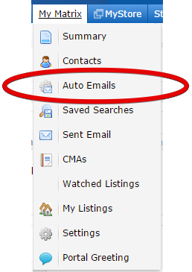
Auto Emails: Status
To Manage Auto Emails go to My Matrix -> “auto emails”
Shows all auto emails and their status:
Initial auto email sent, link not clicked yet
Active and Sending
Deactivated
Can only become deactivated in 1 of 3 ways:
Goes 60 days without becoming active
Client deactivates/unsubscribes
You deactivate it
Note: if an auto email goes 50 days without a single update or new listing or it is not visited in 90 days it will deactivate
Notes:
To manage your auto emails hover over the my matrix tab and click on the auto emails option. This will take you to a list of all the auto emails that you have setup . The list shows the status of the auto email, subject, contact, bcc, schedule, and the last time the contact visited the portal.
The auto email will be in one of 3 statuses:
Green circle with a white center: welcome email has been sent but the link has not been clicked
Green circle with a checkmark: Auto email is active and sending
Red circle with an exclamation mark: Auto email is deactivated
In matrix there is only 3 ways an auto email can become deactivated. The client or the member deactivates it, or it goes 60 days without becoming active. There is no time limit to auto emails, they will continue to send as long as there is new or updated listings for the criteria.

Slide 59
Auto Emails: Management
To Change and work with the auto email click the or click on the title of the email
Settings: Change recipient, schedule and deactivate
Criteria: change search parameters
Results: see all matching properties
Date since: see all matches since last time results or date since viewed
Market Update: search results for specific types of changes
Open in Portal: View recipients portal in BCC Mode
Resend Welcome: Resend the welcome email once
Delete Auto Email
Notes:
To manage an auto email, click on the subject of the auto email and this will open up the auto email menu. From here you can manage all of the different settings of the auto email.
Settings: This will take you to the auto email settings page. On this page you can change everything about the auto email. You can change who it is going to, the recurring message, schedule and also disable the auto email. After you have made the changes click save and this will apply the changes to the auto email.
Criteria: This option allows you to adjust the criteria of the auto email. If your clients needs change or you need to narrow or expand the criteria you can do this here. After the criteria has been changed click save to apply the changes to the auto email. This will also take you to the settings page, if you have nothing to change scroll to the bottom and click save again.
Results: Go to a list of all the results for the auto email’s criteria
Date Since: All results that are new or updated since the last run date of the auto email. This is handy to use for if you are not checking the results for a couple days and just want to see what is new since the last time you checked.
Market Update: This option allows you to search the results for specific changes in listings. When clicked you will be taken to the market update page. From here you can choose the change type to search for, either Price or Status. You then choose when you want to look for those changes. You can use either the last run date or set a custom time frame. After all the options have been set click the search button to see the results that match the selected change type within the selected time period.
Open in portal: opens the portal in BCC mode the same way the icon on the recent portal visitors widget does.
Resend welcome: This option is only available on auto emails with the unactivated status (green circle with a white center). It can be used once per auto email to resend the initial welcome email to the contact.
Delete Auto Email: This will permanently delete the auto email. Once it is deleted we have no way of recovering it.

Slide 60
Class Activity: Managing Auto Email
Time 5 Minutes
Delete the Auto Email created in the previous Activity

Slide 61
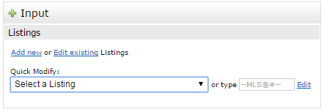
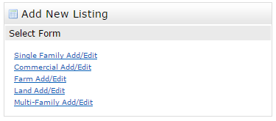
Input / Broker load
Start a new listing from the input tab
Click Add new
Select property type to list
Clone from existing MLS® number, Fill from GeoWarehouse or start blank listing entry

Slide 62
Navigation
DO NOT USE THE BACK BUTTON
This will erase any of the information you typed in that tab
Use the tabs at the top of the input section to move between tabs

Slide 63
Starting and Navigating Demonstration

Slide 64
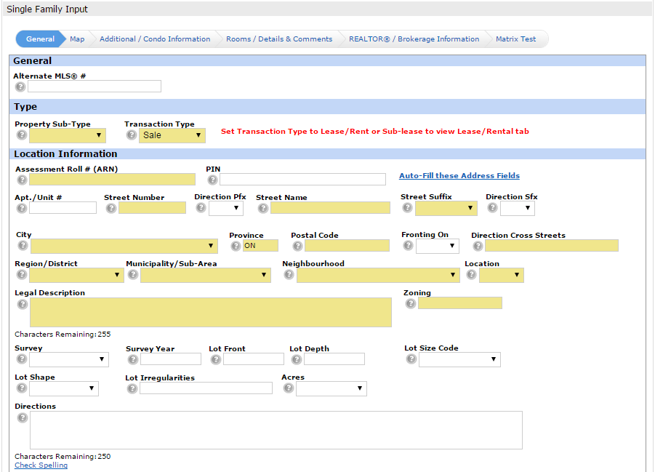
General
Transaction Type
Property Sub Type
Address and Property Data
Price, appointments, possession

Slide 65
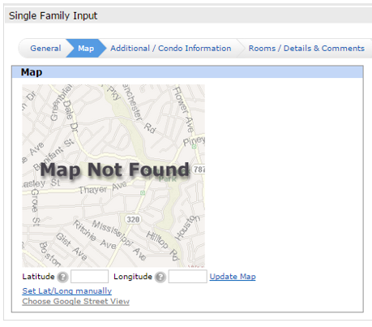
Map
The map is not plotted automatically
Used by REALTOR.ca and Matrix for location information
Use to manually place pin on map

Slide 66
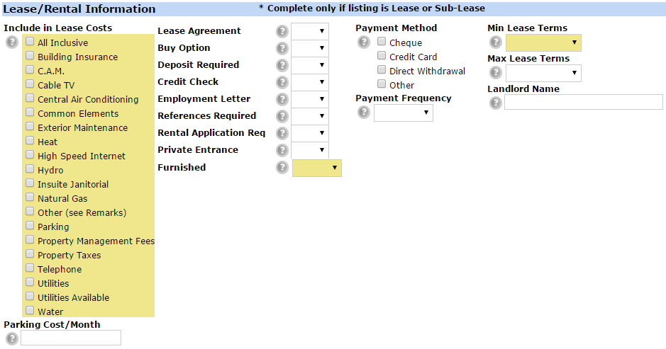
Lease/Rental
Tab only appears when transaction type is Lease/Rental
Details of the rental
Included in costs
Parking
Payment
etc

Slide 67
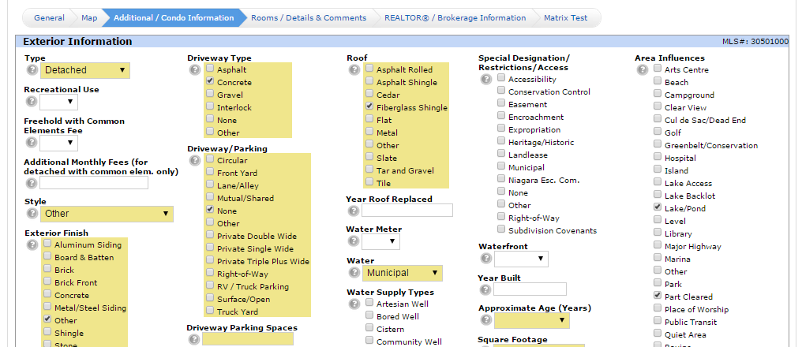
Additional/Condo Information
All details about the property
Condo section only mandatory if property subtype is condominium

Slide 68
Waterfront
Define the Specific details about the waterfront for the property

Slide 69
Rooms/Details & Comments
Room Level and Type
Dimensions (mandatory for all rooms except bathrooms)
Select the Units to enter in and the system converts to the other
Feature codes for rooms

Slide 70
Creating and Adding Rooms Examples

Slide 71
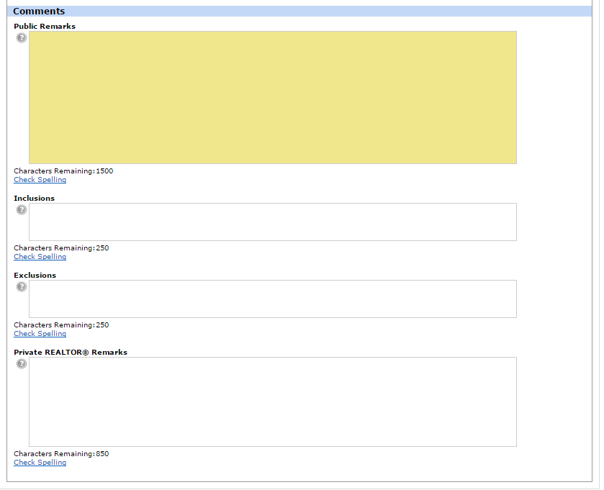
Rooms/Details & Comments
Public Remarks for the Portal and REALTOR.ca
Inclusions and Exclusions
REALTOR® Remarks for showing instructions

Slide 72
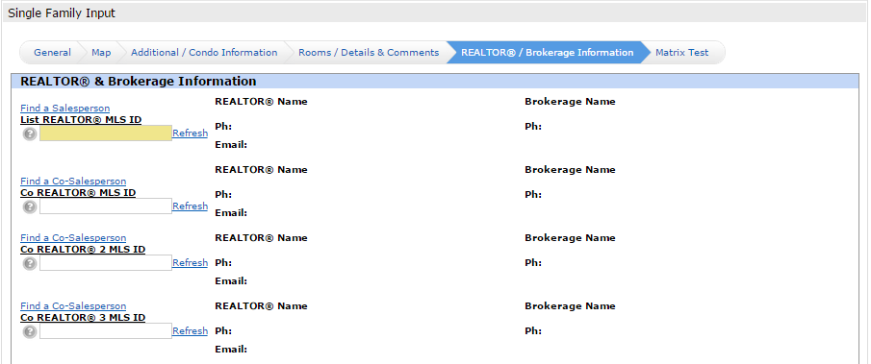
REALTOR®/Brokerage Information
Your Salesperson Information will pre populate
Add co listing SPs

Slide 73
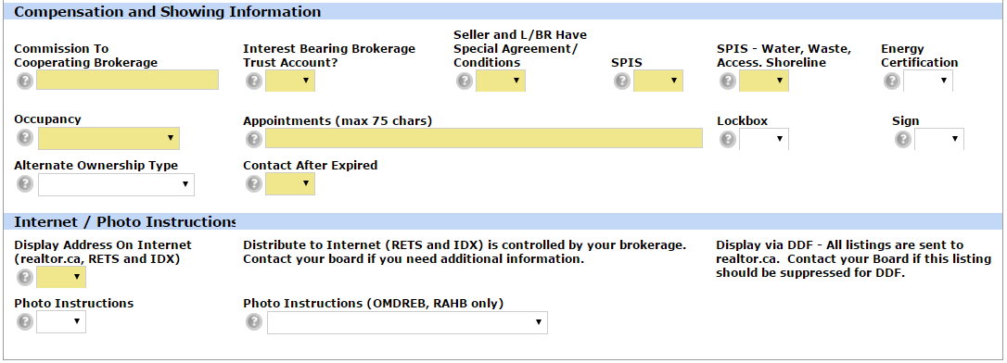
REALTOR®/Brokerage Information
Enter all information for appointments and disclosures

Slide 74
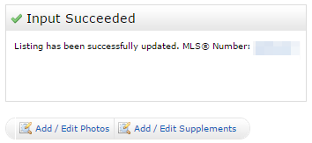
Submitting a Listing
When finished click submit
Errors in input will show on the tabs and beside the fields with red exclamation marks
Use save as incomplete to create an incoming listing
Pre Load listing
Print Data Form
Add pictures and supplements before making live
Once a listing is submitted (incomplete or fully complete) Always edit from the issued MLS® number

Slide 75
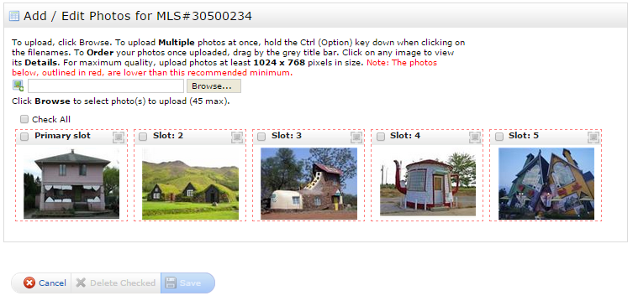
Adding Pictures
3 Ways to add photos:
When first submitting
My Listings
Input tab
Add up to 50 Photos
Re-arrange by dragging and dropping
Recommended size 1024 X 768
Red Border = too small

Slide 76
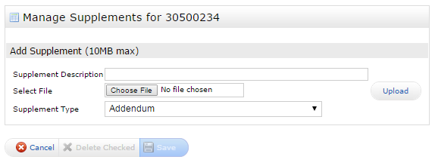
Adding Supplements
3 Ways to add photos:
When first submitting
My Listings
Input tab
Must be PDF Format
Enter name,
Select supplement type
5 Max, 10MB Max

Slide 77
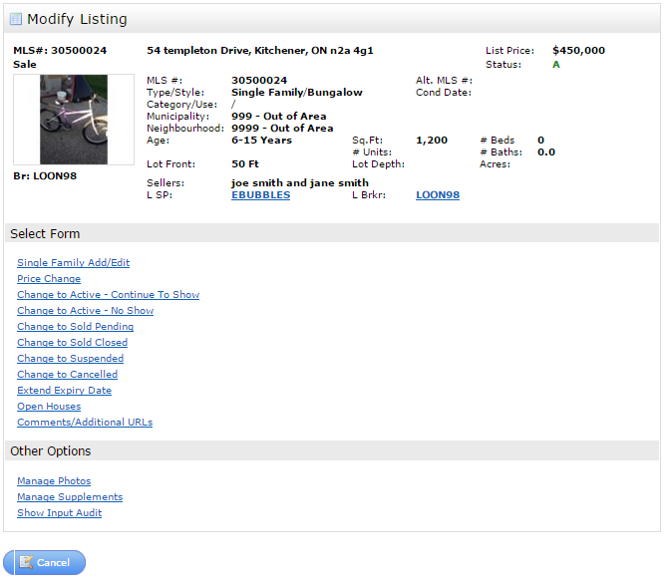
Editing a Listing
2 ways to edit
Input tab
My Listings
Add Virtual Tours with
Notes:
Add/Edit – Change Property Details
Price Change – Edit Price

Slide 78
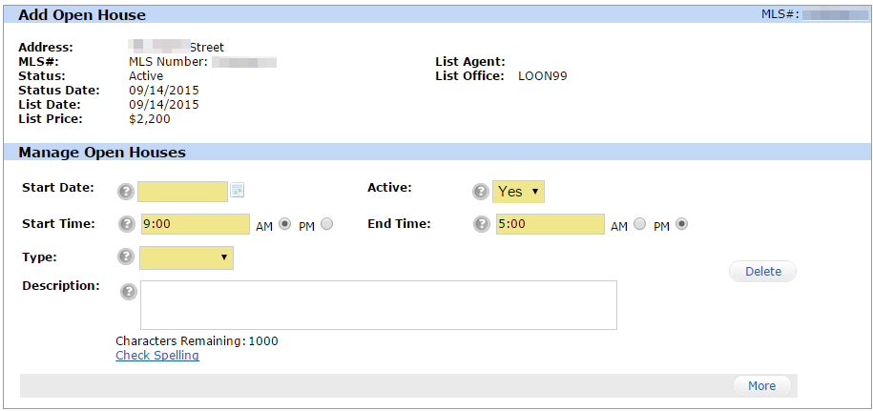
Adding an Open House
Set Dates and Times
Note make sure to specify AM/PM
Click more to add additional open houses

Slide 79
Adding an Open House Example

Slide 80
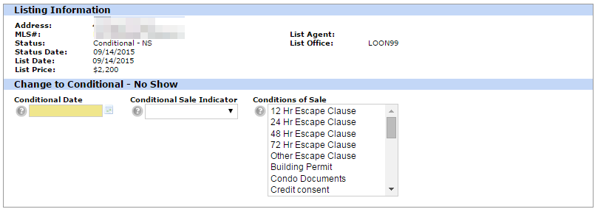
Reporting Sales – Conditional Sale
2 Types:
Active CS – Conditional but continue to show
Conditional NS – Conditional but no more showings
Use either or to report as conditional sale

Slide 81
Reporting Sales – Pending Sale
Reported as Pending sale
Use to Report
Enter price and dates
Enter in selling SPs Code (can be looked up using link)
For OOB enter NONMLS
Automatically Closes

Slide 82
Input/edit examples

Slide 83
Thank You for Coming

